Slide 1

Introduction to Dashboard Design
Task 4 – Dashboard Design in Power BI
Layeba Sayyed | Elevate Labs Data Analyst Intern

Slide 2

Task Overview
Project Goals and Deliverables
The objective of this project is to build an interactive dashboard for stakeholders using Power BI, leveraging the Video Game Sales dataset for insightful data visualization and decision-making.
NOTES ON OBJECTIVE
2

Slide 3
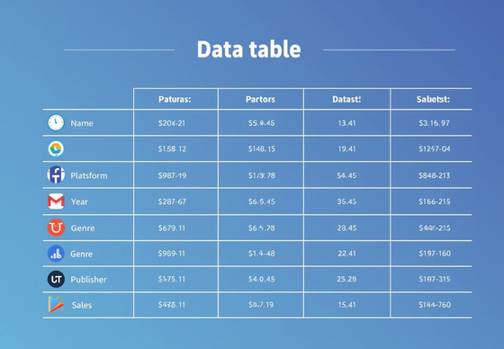
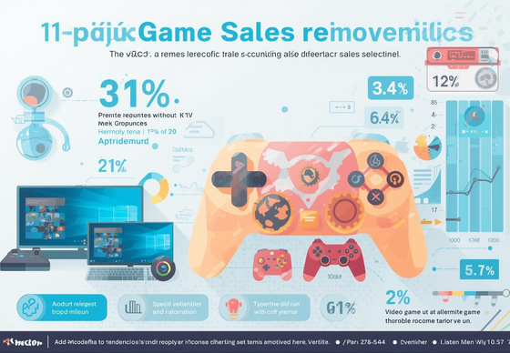

Dataset Overview
Dataset Structure
The dataset includes essential columns that provide insights into video game sales trends across various platforms.
Key Attributes Explained
Sales Trends
Visual representation of data trends helps in understanding the performance of different video games across various platforms.
Global Analytics
Understanding global and regional sales allows for effective strategies in targeting the gaming market and improving sales.
DATASET INSIGHTS
3

Slide 4
Selected KPIs Overview
Total Global Sales
Measures the cumulative revenue generated from all games.
Number of Games
Tracks the total count of unique video games released.
Average Sales
Calculates the mean sales figures for individual games.
KEY PERFORMANCE INDICATORS
4

Slide 5
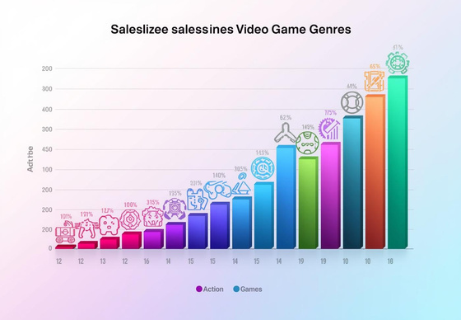
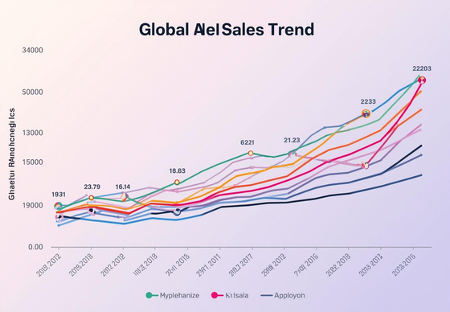
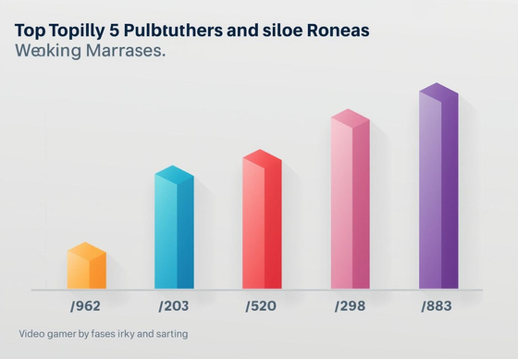
Sales by Genre Analysis
Sales Data Overview
This chart presents an engaging overview of video game sales categorized by genre, showcasing trends and insights.
Insights from Dashboard
Yearly Sales Trend
The line chart effectively demonstrates the fluctuations in video game sales over the years, providing clear insights into market dynamics.
Top Publishers Insights
This bar chart highlights the performance of major video game publishers, making it easy to identify industry leaders and trends.
NOTES AND OBSERVATIONS
5

Slide 6
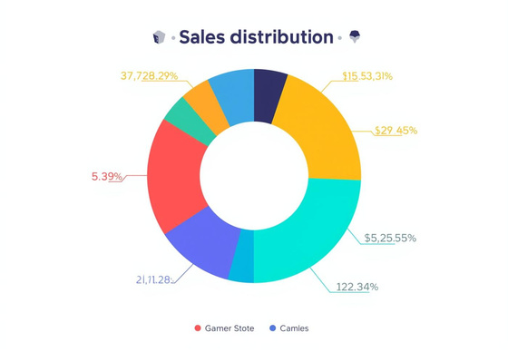
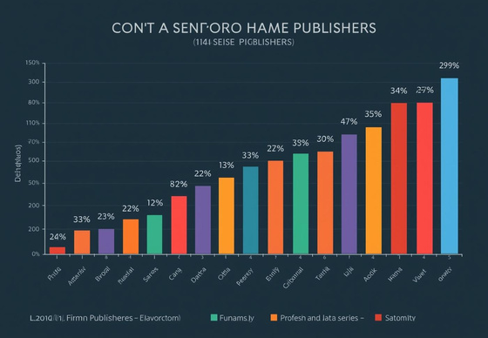
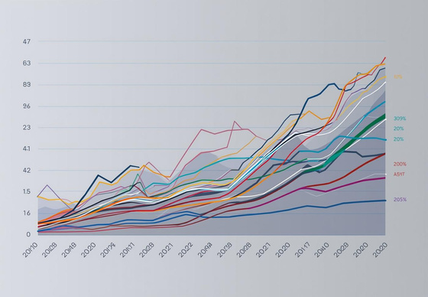
Publisher Insights
Sales Distribution
This donut chart visually represents the distribution of global game sales across various platforms, indicating market trends.
Key Performance Metrics
Publisher Performance
The column chart illustrates the sales performance of top publishers, highlighting their contributions to the overall market landscape.
Sales Trend Over Time
This line chart tracks publisher sales trends over the years, providing insights into growth patterns and market shifts.
ADDITIONAL INSIGHTS
6

Slide 7
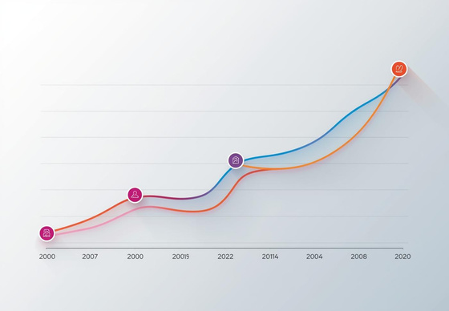
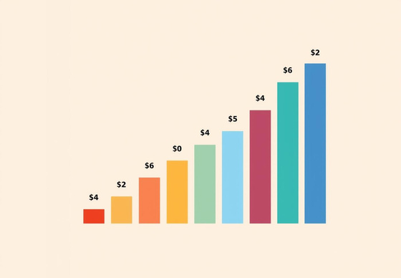
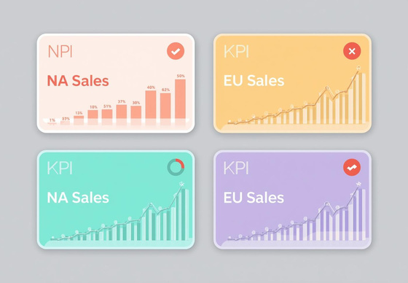
Regional Insights
Line Chart Trends
The line chart illustrates regional sales trends over time, highlighting shifts in market performance across different areas.
Understanding Sales Trends
Column Chart Overview
This column chart provides a visual comparison of sales performance among various regions, indicating key market leaders effectively.
KPI Cards Display
The KPI cards succinctly present critical sales figures, allowing stakeholders to quickly assess regional performance metrics and insights.
NOTES AND OBSERVATIONS
7

Slide 8
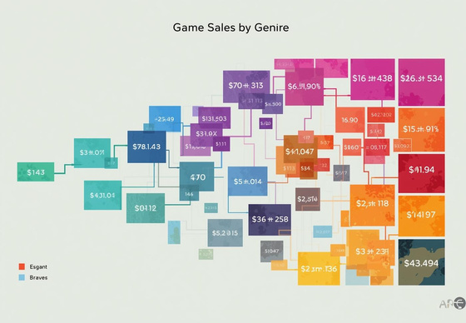
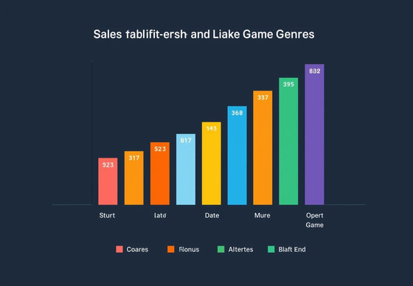
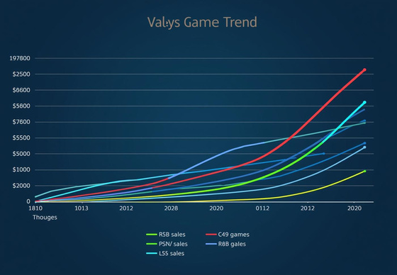
Genre Performance
Treemap Visualization
This treemap effectively captures the distribution of sales across various game genres, illustrating market performance.
Visualizing Sales Trends
Bar Chart Overview
The bar chart provides a clear view of sales performance across genres, making it easy to identify trends.
Line Chart Trends
This line chart highlights the yearly sales trends in genres, demonstrating shifts and patterns over time.
INSIGHTS SUMMARY
8

Slide 9
Interactivity and Dashboard Features
Slicers/Filters
Slicers allow users to dynamically filter data for insights.
Color Themes
Consistent color themes enhance visual harmony and user experience.
Data Labels
Data labels improve readability and make key figures clear.
KEY TAKEAWAYS
9

Slide 10
Key Insights & Business Value
Genres
The best performing genres reveal strong consumer preferences and trends.
Publishers
Leading publishers showcase the most successful titles in the market.
Demand Patterns
Regional demand patterns provide crucial insights into sales strategies.
SUMMARY OF INSIGHTS
10

Slide 11

Conclusion Insights
Strategic Decision-Making with Data
The dashboard provides clarity in data visualization, enabling stakeholders to make informed decisions. With clear KPIs and insightful trends, it enhances engagement and optimizes business strategies effectively.
SUMMARY OF KEY POINTS
11

